Slide 1
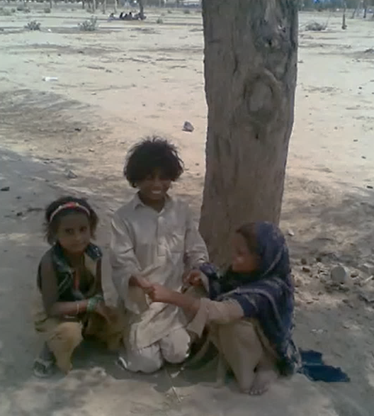
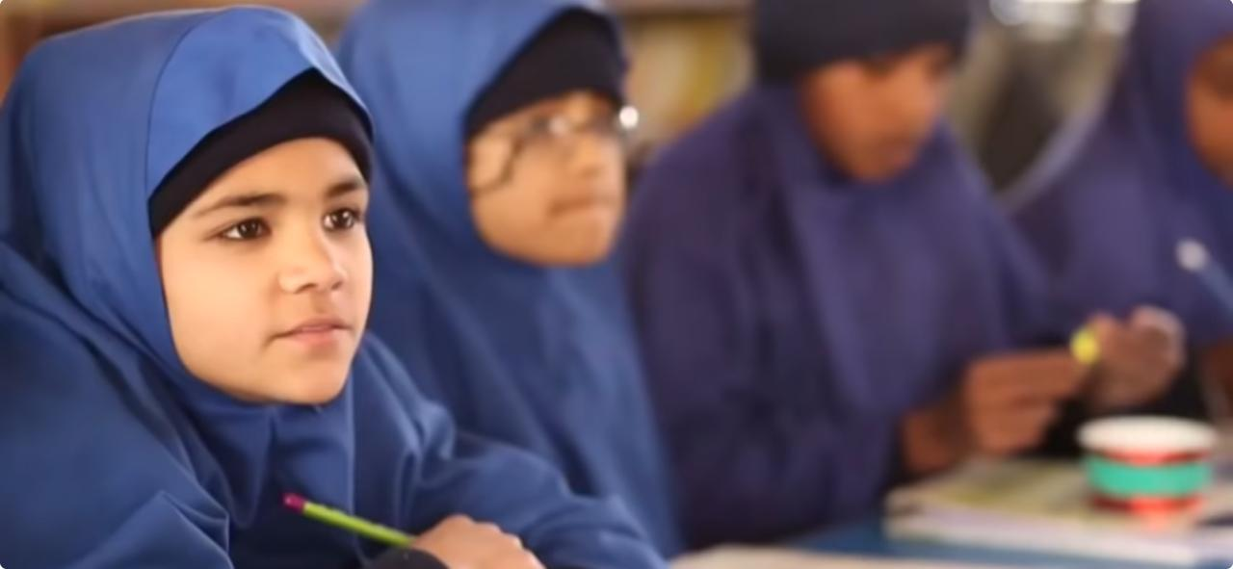
Brining Out-of-School Children back to school
Projects offered to NUST students for Community Service
iFeel: International Foundation for Education, Empowerment and Learning
www.ifeel.pk
www.facebook.com/oscschool
To express interest and sign up for any of the offered projects, students shall please reach out to Ms. Mahrin Iqbal at: Phone: 03235197023, Email: mahrins@gmail.com

Slide 2
iFeel: International Foundation for Education, Empowerment and Learning
Purpose of the Projects
www.ifeel.pk,
www.facebook.com/oscschool

Slide 3
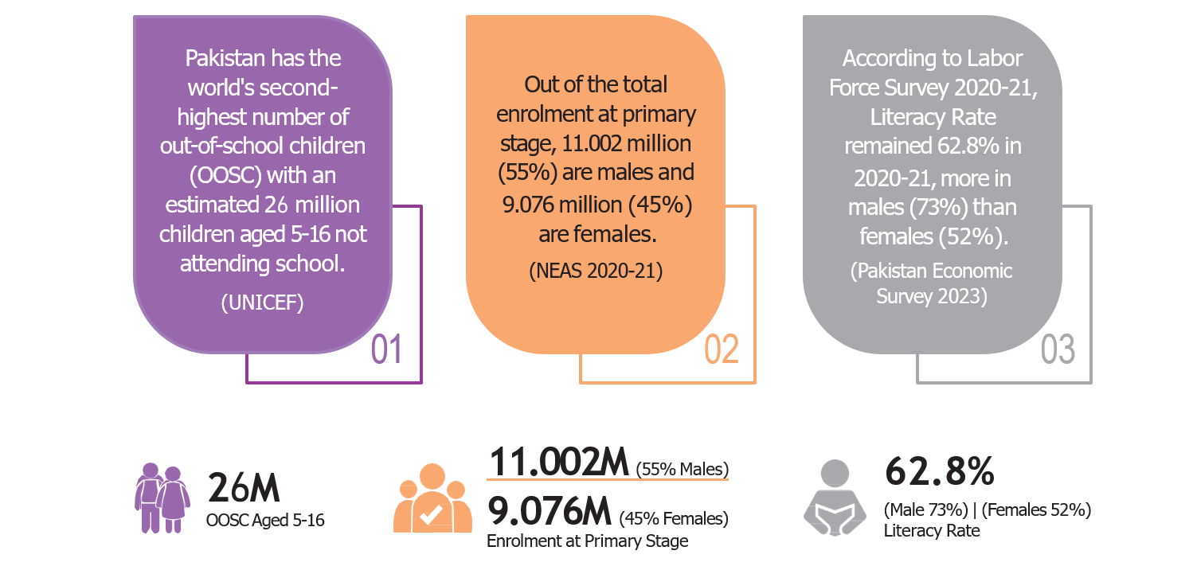
The Problem at hand

Slide 4
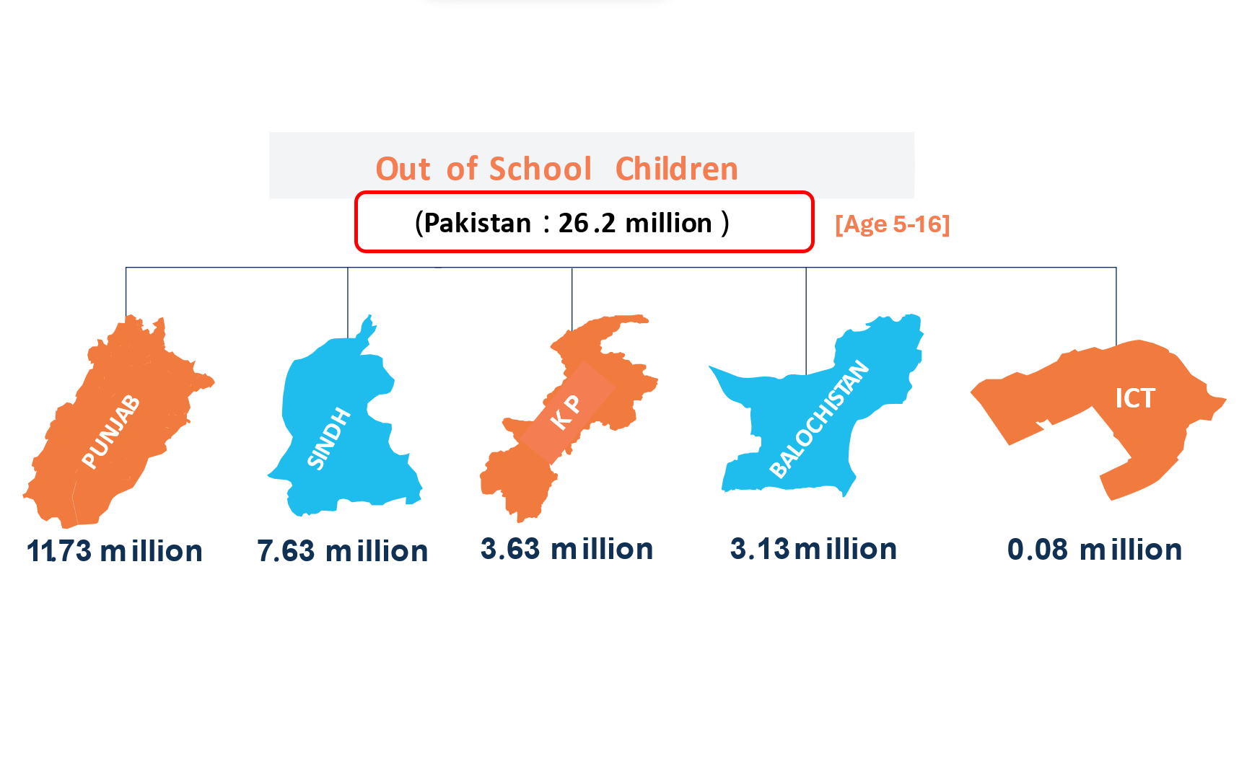

Slide 5
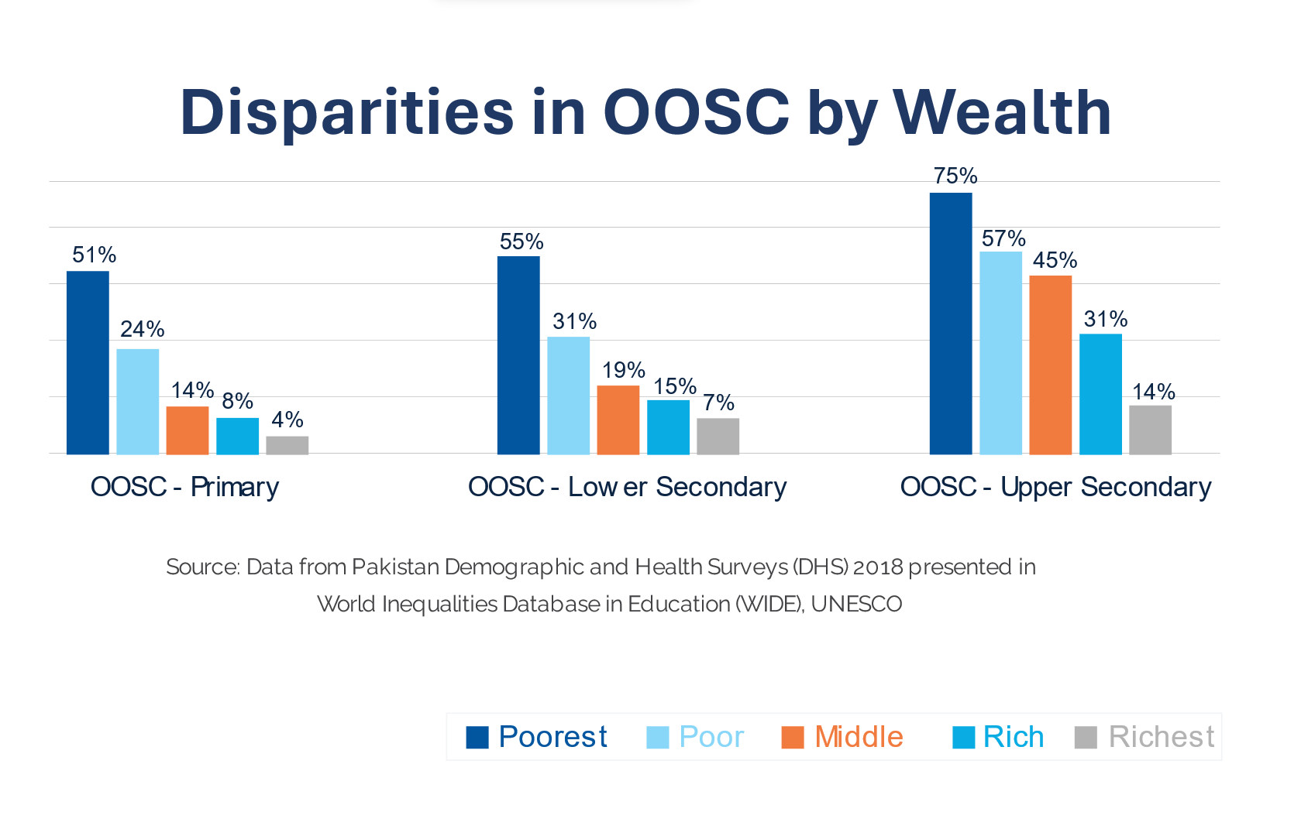

Slide 6
Some urgent steps needed – nation wide
A campaign on war footings similar to Covid
Public msgs on mobiles and posters to be spread
Parent Meetings by teachers
Community Meetings/ Involving masajid
Larger Enrollment Campaigns
Door-to-Door Campaigns
Focus Group Discussions (FGD’s)
(Possible only in larger cities or densely populated areas)

Slide 7
Capacity building and finding volunteers
Community Service by University and College students
Teach for Pakistan similar to teach for America model
Short training program for O-levels, Matric till University level, enabling them to teach reading during their summer break
University students - 20 hours tasks of online learning programs through games for non formal learning

Slide 8
iFeel: offers…
17 schools all over Islamabad to bring more than 1000 children back to school every year. Current enrollment 2000
Free accelerated primary programs for older aged students
No free periods in class, proper replacement plan for teachers on leave
A friendly and loving environment
Teaching morals and ethics
Monthly prizes for full attendance
No need for tuition after school
Monthly ration for orphan kids in our schools

Slide 9
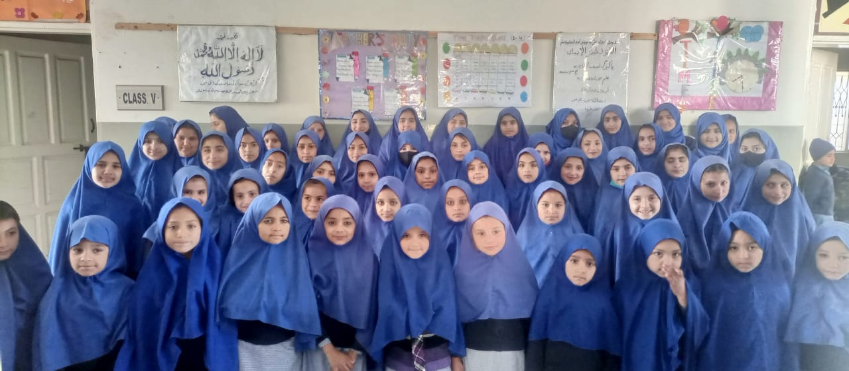
Some key practices at iFeel special focus on Smile and Salaam

Slide 10
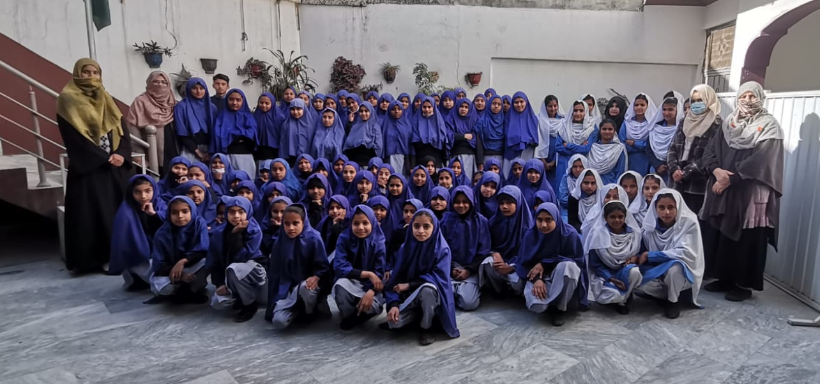
Some key practices at iFeel Ready to support till the very end

Slide 11
Equal importance to both sides of the picture
Formal
Non Formal
Hybrid

Slide 12
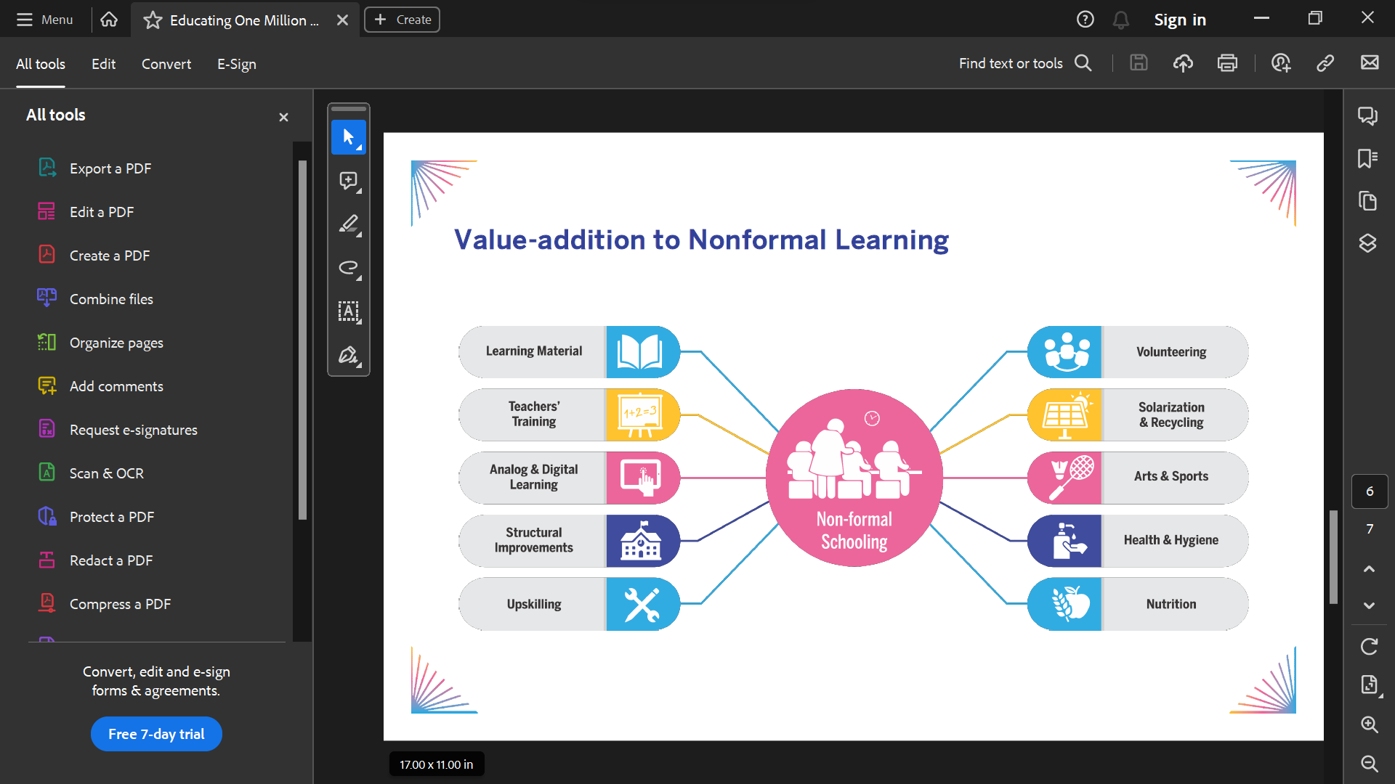
Areas available for development of programs

Slide 13
Our LOCATIONS
1. Tarnol (Main GT Road) 10. G-6/2
2. D-14 (Sara e Kharbooza) 11. I-8/1
3. G-14 (Pind Paracha) 12. I-9/1
4. F-12 (Mera Akku) 13. I-10/4
5. F-12 (Mera Jaffar) 14. Westridge (Friend’s Hospital)
6. F-11/1 15. Dhallah (1 hour drive from NUST)
7. E-11 (Golra) 16. Ghora Mast (1 hour drive from NUST)
8. E-9 (PAF) 17. Swan Camp (near Bahria Phase 7)
9. G-8/4

Slide 14
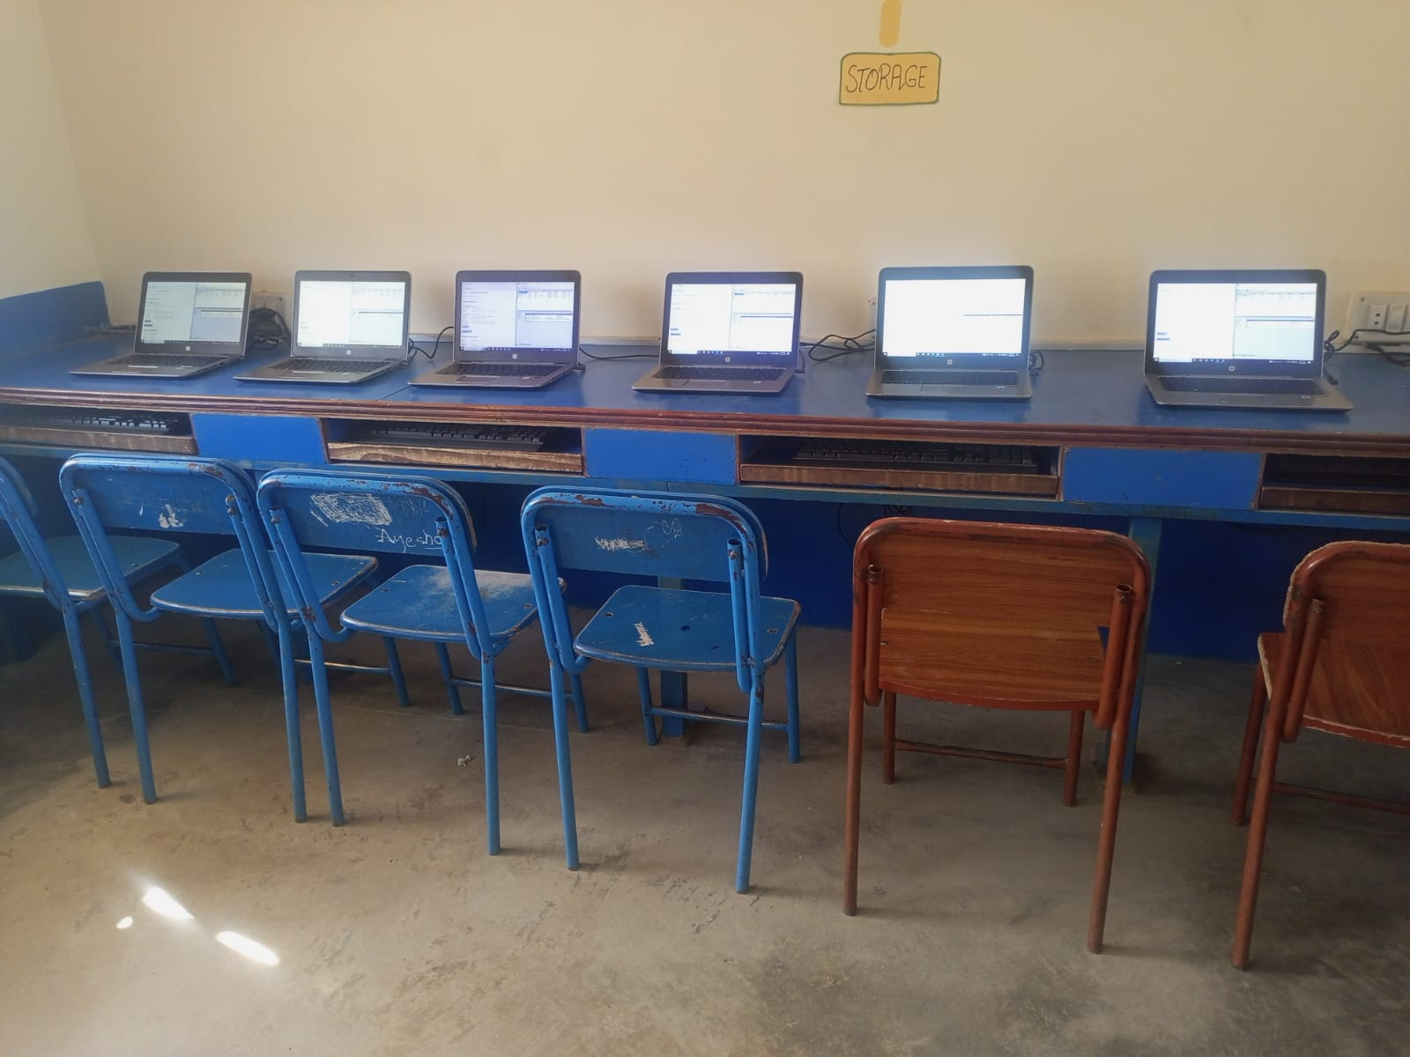
CS Project 1 – Computer Training
iFeel: for tech
Location: IFeel Community Model School Dhallah
Boys and Girls
Class 8 - 10
Location: IFeel Community Model School Ghora Mast
Girls
Class 8 -10

Slide 15
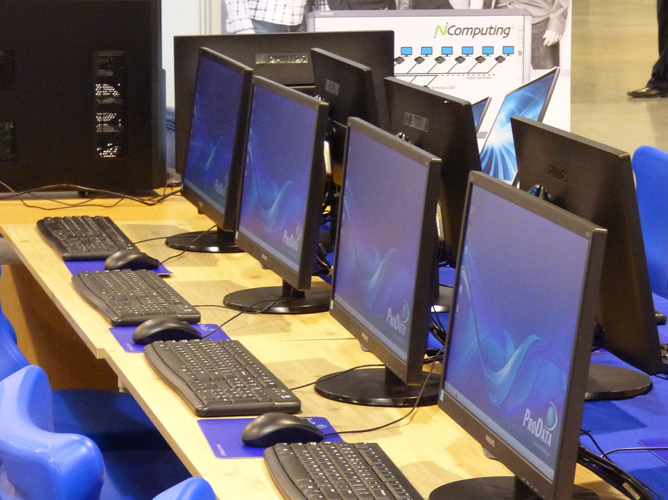
CS Project 2 – Set up Computer Lab F-12
iFeel: for tech
Location : F-12 (Mera Jaffar)
Used computers lab setup (4-5)
basic computer training
Girls only - Class 8

Slide 16
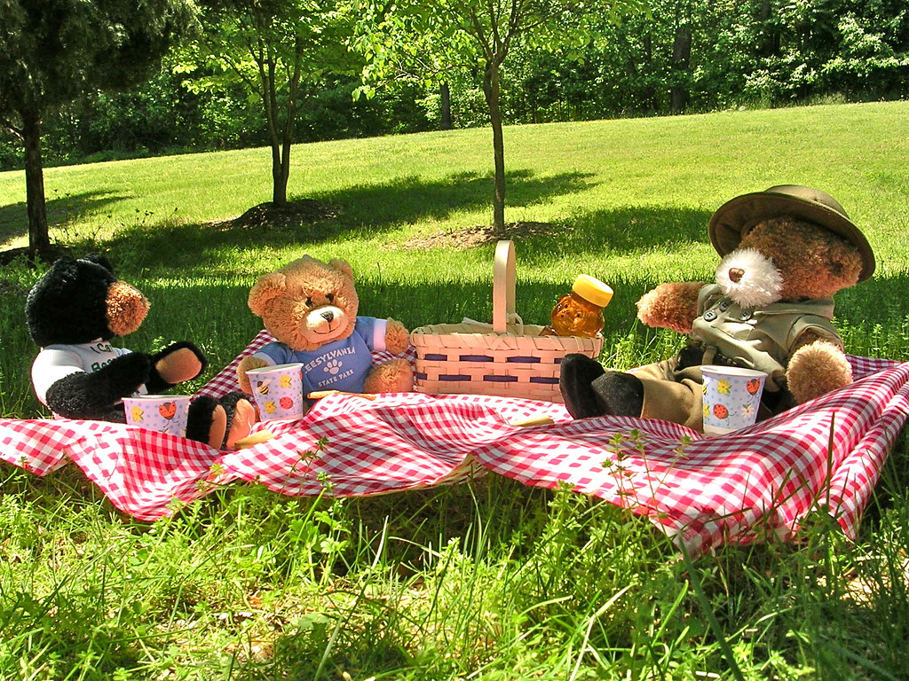
CS Project 3 – Educational Trips
iFeel: for education
Location: Per Choice
Lok Virsa Museum
Natural History Museum
Pakistan Monument
Group of 20-25 students
Pre Visit information session : Visit + Picnic & getting to know the children
Post visit : quiz/creative writing competition

Slide 17
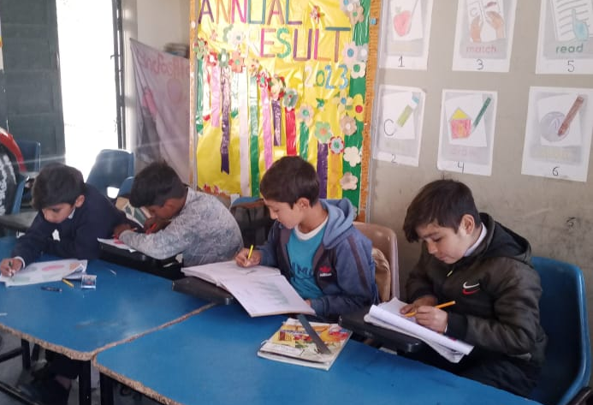
CS Project 4 – iFeel for Orphans
iFeel: for orphans
Location: Per Choice
Sponsor an orphan for a year
Meet and learn about their lives
Fundraising –
sponsorship for one year (Rs.60,000)

Slide 18

CS Project 5 A– iFeel for Hunger
iFeel: for hunger
Distribution of ration boxes for the most needy student families
Locations to choose from:
F-12 (Mehra Jaffer)
F-11
Dhallah
Ghora Mast
Food and Dry Ration

Slide 19
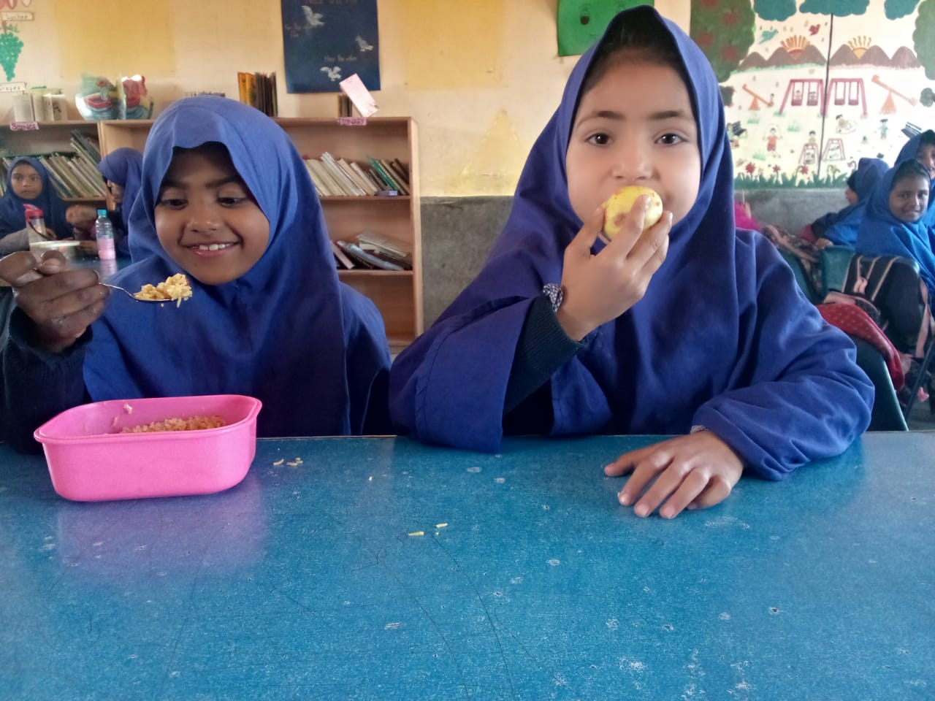
CS Project 5 B – iFeel for Hunger
iFeel: for hunger
Arranging Lunch packs and Rice Daighs and serve students at schools
On going daily activity
Days can be selected as per need
Location: per choice

Slide 20
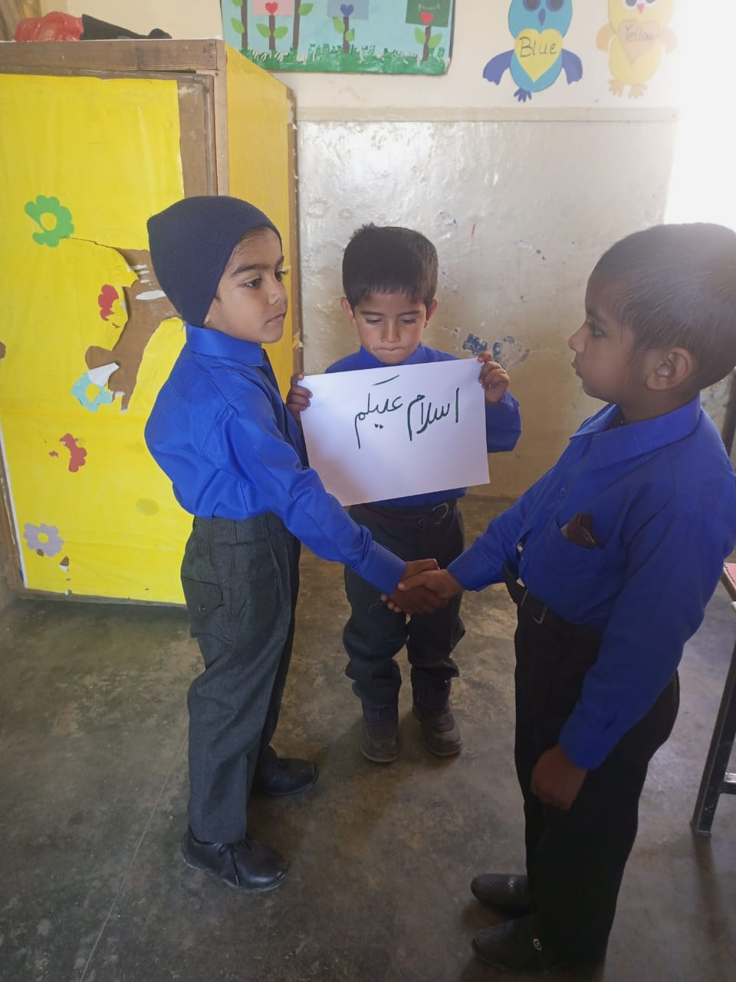
CS Project 6 – Buddy for life
iFeel: for education
Location: Per Choice
Become a friend for life
For children ages 5 till 17
Connect, inspire, and be inspired
Help with studies, career counselling

Slide 21
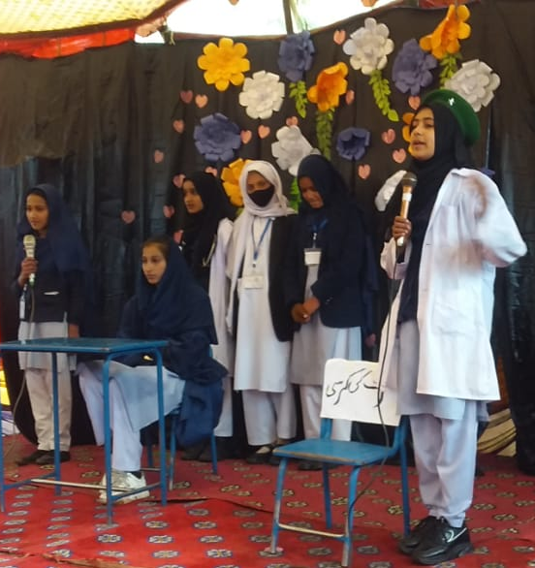
CS Project 7 – Career Counselling
iFeel: for education
Location:
Dhallah
Ghora Mast
Class 8 onwards
Preparing CVs
Career options and educational paths

Slide 22

CS Project 8 – iFeel Newsletter
iFeel: for education
Location: Flexible
Schools visits
Photography where required
Proof read
Print ready

Slide 23

CS Project 9 – iFeel for Health
iFeel: for health
Medical camp
Information session –
Healthy Living Tips
healthy vs. junk food
Information session –
Importance of exercise
Sports activities

Slide 24

CS Project 10 – Marketing
iFeel: for education
Learn about IFEEL and its projects
Spread awareness among friends and families
Find 25 new sponsors with commitment to sponsor for minimum one year (Rs.2,000/student/month)

Slide 25
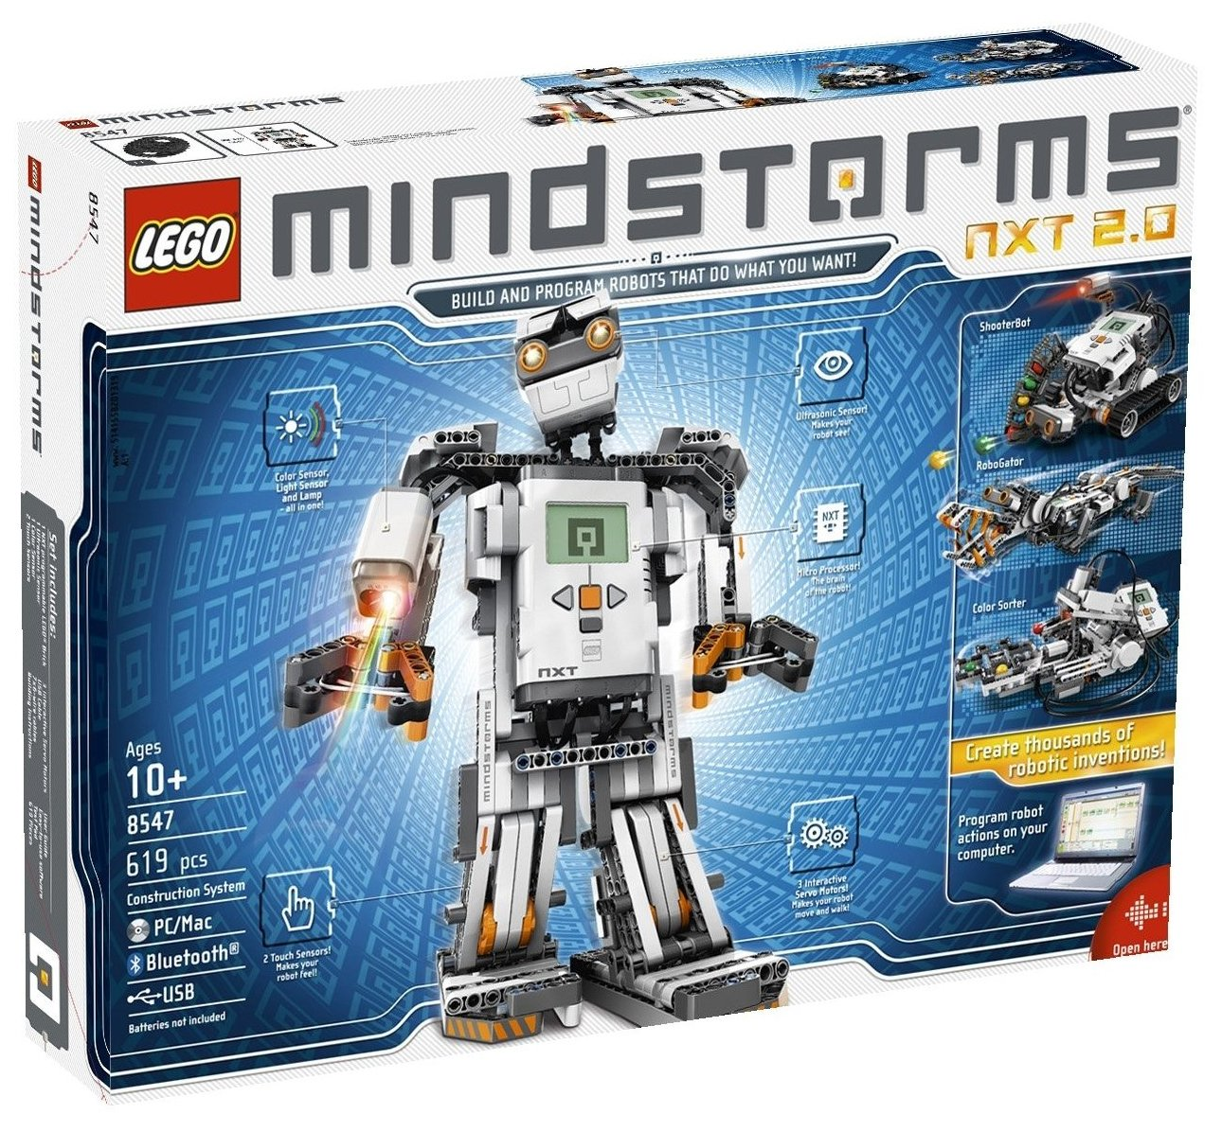
CS Project 11 – STEM Activities
iFeel: for education
F-12 – Girls, class 5
Dhalla – Girls + Boys Matric
LEGO building/construction activities
LEGO Mindstorm programming activities
Relating Math+Science concepts learned in class

Slide 26
CS Project 12 – New branch
iFeel: for education
Survey of kachi basti near NUST to evaluate the number of overage out of school children
Help find a suitable location for school
Help set up school
Take teacher training and teach in school

